Slide 1
SUPER BOWL (DATA MINING)
Presented By :-
PUSP KUMAR VYAS

Slide 2
Introduction
we're going to find out how some of the elements of Super Bowl
interact with each other. After exploring and cleaning our data a little, we're going to analyse data to answer questions like:
What are the most extreme game outcomes?
How does the game affect television viewership?
How have viewership, TV ratings, and ad cost evolved over time?
Who are the most prolific musicians in terms of halftime show performances?

Slide 3
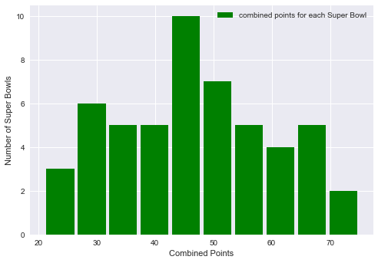
What are the most extreme game outcomes?
Combined points

Slide 4
Super Bowls with the highest and lowest combined scores
Date super bowl combined points
1995-01-29 29 75 (Highest)
1973-01-14 7 21 (Lowest)

Slide 5
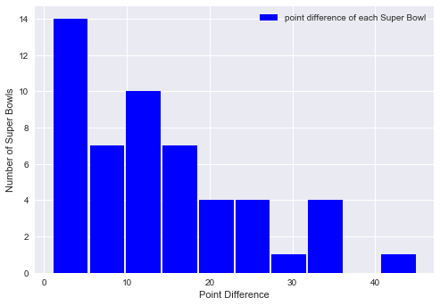
Point difference distribution

Slide 6
Super Bowls with the highest and lowest
Point difference
Date super bowl Point difference
1990-01-28 24 45 (Highest)
1991-01-27 25 1 (Lowest)

Slide 7
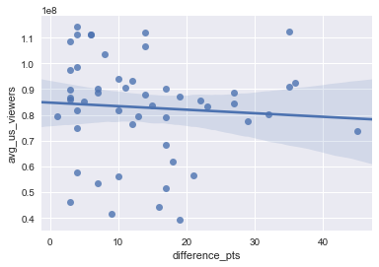
How does the game Difference Points affect television viewership?
Slope = 0.00125 or ( 12.891 Degree) or (0.07161 Radian)
There is no sudden transition in US Viewers if there is change
Difference Point .

Slide 8
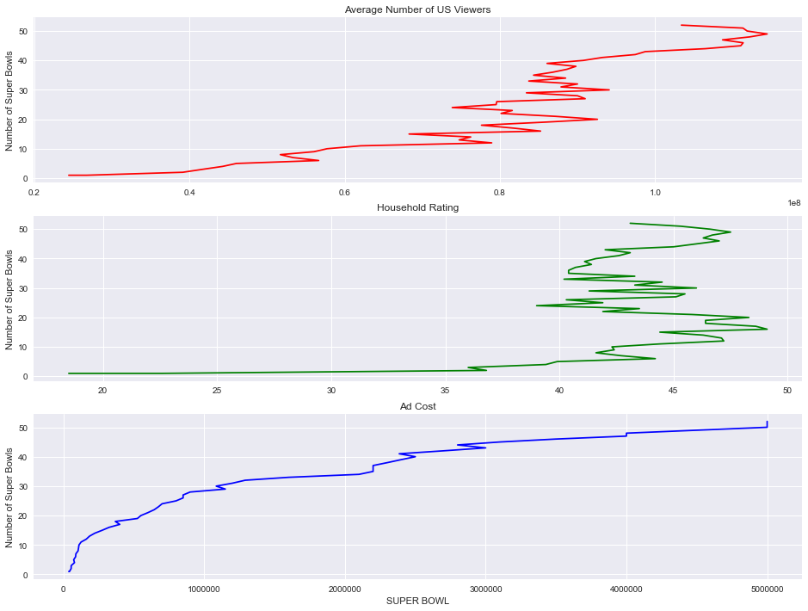
How have viewership, TV ratings, and ad cost evolved over time?

Slide 9
Who are the most prolific musicians in terms of halftime show performances?
Musician(most halftime show appearances)
Grambling State University Tiger Marching Band
Up with People
Al Hirt
The Human Jukebox
Spirit of Troy
Florida A&M University Marching 100 Band
Gloria Estefan
University of Minnesota Marching Band
Bruno Mars
Pete Fountain
Beyoncé
Justin Timberlake
Los Angeles Unified School District All City H...

Slide 10
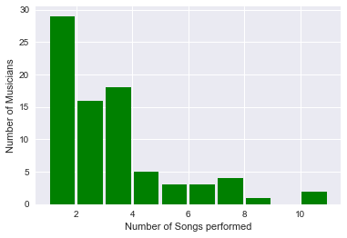
Who performed the most songs in
a halftime show?

Slide 11
Super Bowl | Musician | Number of songs
52 | Justin Timberlake | 11.0
30 | Diana Ross | 10.0
49 | Katy Perry | 8.0
51 | Lady Gaga | 7.0
23 | Elvis Presto | 7.0
41 | Prince | 7.0
47 | Beyoncé | 7.0
48 | Bruno Mars | 6.0
50 | Coldplay | 6.0
45 | The Black Eyed Peas | 6.0
46 | Madonna | 5.0
44 | The Who | 5.0

Slide 12
In this notebook, we loaded, cleaned, then explored Super Bowl game, television, and halftime show data. We visualized the distributions of combined points, point differences, and halftime show performances using histograms. We used line plots to see how ad cost increases lagged behind viewership increases. And we discovered that blowouts do appear to lead to a drop in viewers.
Conclusion

Slide 13
THANK YOU !

